Slide 1

BREAST CANCER CLASSIFICATION USING DEEP LEARNING ANALYSIS
An in-depth exploration of innovative deep learning methodologies for advancing breast cancer classification and diagnosis in modern medicine.
Swarnamoy Ghosh
M.Sc.(Tech) Statistics and Data Science

Slide 2





BREAST CANCER INSIGHTS
UNDERSTANDING BREAST CANCER
Most Common
Cancer
Breast cancer is the most diagnosed cancer globally, with 2.3 million new cases in 2020, accounting for 11.7% of all cancer diagnoses.
Global Mortality
It caused approximately 685,000 deaths in 2020, with higher mortality rates in low- and middle-income countries due to limited access to early detection and treatment.
Risk Factors
Key risk factors include obesity, alcohol consumption, family history, and genetic mutations.
Survival Rates
Early detection and treatment result in 90%+ survival rates in high-income countries, but survival drops to 40–60% in low-income regions due to delayed diagnosis.
Global Efforts
Organizations like WHO are working to reduce breast cancer mortality by 2.5% annually by 2040 through improved screening, awareness campaigns, and access to care.

Slide 3





BREAST CANCER DIAGNOSIS
BREAST CANCER CLASSIFICATION USING DEEP LEARNING
Breast cancer prevalence among woman worldwide
Breast cancer is a major global health challenge and the most common cancer in women, underscoring the need for effective diagnostics.
Importance of early detection and accurate diagnosis
Timely breast cancer detection boosts treatment success and survival, emphasizing the need for advanced diagnostics.
Role of deep learning and CNNs in image classification
Deep learning, particularly Convolutional Neural Networks (CNNs), has emerged as a powerful approach for analyzing medical images, improving classification accuracy in breast cancer diagnostics.
Benefits of automating the diagnostic process for pathologists
Deep learning automation eases pathologists' workload, enabling efficient diagnoses and focused care.
Enhancing patient care through advanced technologies
Deep learning in breast cancer classification ensures accurate diagnosis and personalized treatment, enhancing patient outcomes.

Slide 4

CONVOLUTIONAL NEURAL NETWORK
ADVANTAGES AND DISADVANTAGES
Definition
Convolutional Neural Network (CNN) is a type of deep learning model specifically designed for processing and analyzing grid-like data, such as images.
CNNs use layers of convolutional filters to automatically extract and learn features like edges, textures, and patterns from input data, making them highly effective for tasks like image recognition, object detection, and medical imaging.
Advantages
Automatic Feature Extraction: Reduces the need for manual feature engineering.
Efficient Parameters: Uses weight sharing to lower parameter count.
Translation Invariance: Recognizes patterns regardless of position.
High Performance: Excels in image-related tasks like classification and detection.
Transfer Learning: Pre-trained models can be fine-tuned for specific tasks.
Use Case of CNNs
Medical Imaging
Object Detection
Image Classification
Facial Recognition
Autonomous Vehicles
Agriculture
Retail and E-commerce
Gaming and Augmented Reality
Natural Language Processing (NLP)
Satellite and Remote Sensing
Disadvantages
Data Hungry: Requires large labeled datasets.
Computationally Expensive: Needs high-end hardware for training.
Overfitting Risk: Prone to overfitting on small datasets.
Limited to Images: Works best with grid-structured data like images.
Black Box Nature: Hard to interpret internal workings.

Slide 5

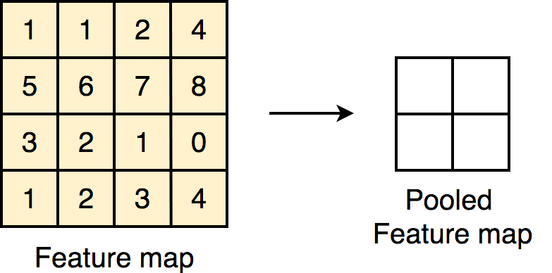
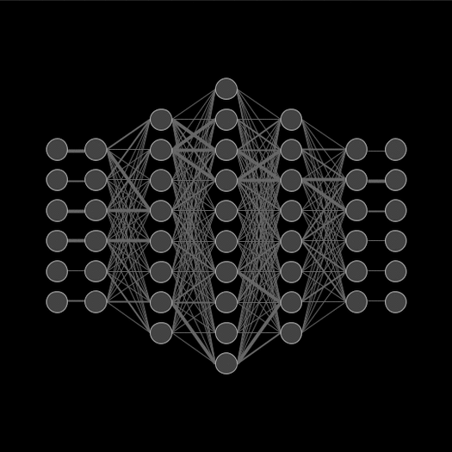
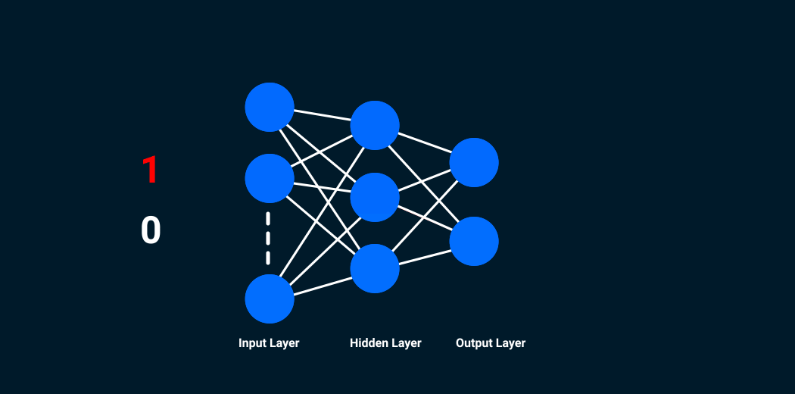
CNN ARCHITECTURE
CNN ARCHITECTURE FOR CLASSIFICATION
OVERVIEW OF KEY COMPONENTS
Convolutional layers
Pooling layers
A convolutional layer is a fundamental building block of Convolutional Neural Networks (CNNs) that applies convolution operations to input data. It uses filters (also called kernels) to scan the input and extract spatial features, such as edges, textures, or patterns, by performing element-wise multiplications and summing the results. This process helps preserve spatial relationships and reduces the dimensionality of data while maintaining critical information for pattern recognition.
A pooling layer in CNNs reduces spatial dimensions by summarizing input regions.
Max Pooling: Retains the maximum value in a window.
Average Pooling: Computes the average in a window.
It reduces complexity, prevents overfitting, and provides translation invariance while preserving key features.
Fully connected layers
Output layers
A fully connected layer in CNNs connects every neuron from the previous layer to every neuron in the current layer. It combines extracted features to make predictions by learning complex relationships. Fully connected layers are typically used in the final stages of the network for classification or regression tasks.
The output layer in a CNN generates the final predictions of the network. It typically has one neuron per class for classification tasks or a single neuron for regression. The activation function (e.g., SoftMax for multi-class classification or sigmoid for binary classification) maps the outputs to probabilities or continuous values, depending on the problem.

Slide 6

1
Dataset for the Project
Sourced from Kaggle, consisting of high-resolution histopathology images labeled as IDC-positive and IDC-negative, crucial for accurate model training.
DATASET OVERVIEW
DATASET UTLIZATION AND PREPROCESSING
2
Image Conversion
Each histopathology image was converted to a numerical array format, facilitating easier manipulation and analysis by machine learning algorithms.
KEY STEPS AND CHALLENGES
3
Normalization
Pixel values were scaled to a range of 0 to 1, which helps in standardizing the input data and improving model performance.
4
Resizing
Images were standardized to dimensions of 50x50 pixels, ensuring uniformity across the dataset and reducing computational load.
5
Imbalanced Dataset
The initial dataset was imbalanced, heavily favoring IDC-negative samples, which could bias the model’s predictions and affect its performance.
6
Overfitting Prevention
Careful tuning of preprocessing steps was required to prevent overfitting, ensuring the model can generalize well to unseen data.

Slide 7
Model Training and Performance Evaluation
Model Performance AND EVALUATION METRICS
90%
High Training Accuracy
The model achieved a training accuracy of approximately 90%, indicating effective learning from the training dataset over 10 epochs.
87%
Stable Validation Accuracy
Validation accuracy stabilized around 87%, suggesting the model's ability to generalize well to unseen data during training.
00.84
Precision (IDC-negative)
The precision for IDC-negative samples is 0.84, reflecting the model's effectiveness in identifying negatives without misclassifying too many positives.
00.89
Precision (IDC-positive)
With a precision of 0.89 for IDC-positive samples, the model demonstrates a strong ability to accurately classify positive cases.
00.90
Recall (IDC-negative)
A recall of 0.90 for IDC-negative indicates that the model is highly effective at correctly identifying negative instances.
00.83
Recall (IDC-positive)
The recall for IDC-positive samples at 0.83 suggests a good balance in capturing positive instances while maintaining precision.
00.87
F1-Score
An F1-score average of 0.87 reflects a strong balance between precision and recall, reinforcing the model's reliability.
00.94
ROC-AUC Score
The AUC score of 0.94 indicates excellent discriminative ability, effectively distinguishing between IDC-positive and IDC-negative samples.
13,148
True Positives
The model identified 13,148 true positive cases, showcasing its strength in detecting actual positive instances effectively.
14,210
True Negatives
With 14,210 true negatives, the model successfully recognized a significant number of negative cases correctly.
1,548
False Positives
The 1,548 false positives indicate areas for improvement in minimizing incorrect classifications of negative cases.
2,609
False Negatives
A total of 2,609 false negatives highlights the need for further refinement to reduce missed positive detections.

Slide 8






CHALLENGES IN MODEL DEVELOPMENT
LIMITATIONS AND FUTURE WORK
GPU Resource Constraints
Generalization Dependence
Diverse Datasets Acquisition
GPU resource constraints, such as limited VRAM, computational bottlenecks, and scalability challenges, can restrict model size, batch dimensions, and training speed. High power consumption and heat generation increase costs, while limited access to powerful GPUs in shared or personal setups may delay model development.
The ability of the model to generalize effectively is heavily reliant on the diversity and comprehensiveness of the training dataset, emphasizing the need for varied data sources.
Future endeavors will prioritize the acquisition of more diverse datasets to enhance the model's robustness and ensure it performs well across different scenarios and populations.
Advanced Architectures Exploration
Clinical Workflow Integration
Hierarchical Model Architecture
Investigating advanced neural network architectures and transfer learning techniques will be essential for improving overall model performance and adaptability.
Integration of the model into clinical workflows is crucial for real-world application, allowing for practical validation and refinement based on user feedback and operational data.
A Hierarchical Convolutional Neural Network (CNN) for medical image classification is designed to predict multiple levels of categories, such as parent and child classes, which is particularly useful for complex medical diagnostics. In medical imaging, diseases often have subtypes or stages, making hierarchical classification a valuable approach.

Slide 9




KEY TAKEAWAYS AND FINDINGS
CONCLUSION
1
2
3
4
Deep learning effectiveness demonstrated
Importance of early detection
Innovative solutions through AI
Need for ongoing research
This project showcases the power of deep learning, specifically CNNs, in accurately classifying breast cancer images, achieving an impressive accuracy of 87% and an AUC of 0.94.
Early detection and precise classification of breast cancer are crucial for effective management and treatment, significantly impacting patient survival rates.
The use of deep learning introduces groundbreaking solutions to the longstanding challenges faced in traditional breast cancer diagnostics, enhancing efficiency and accuracy.
Continuous research and refinement of deep learning models are vital for advancing cancer detection technologies, ensuring they remain effective and relevant in clinical settings.

Slide 10

THANK YOU

